Slide 1
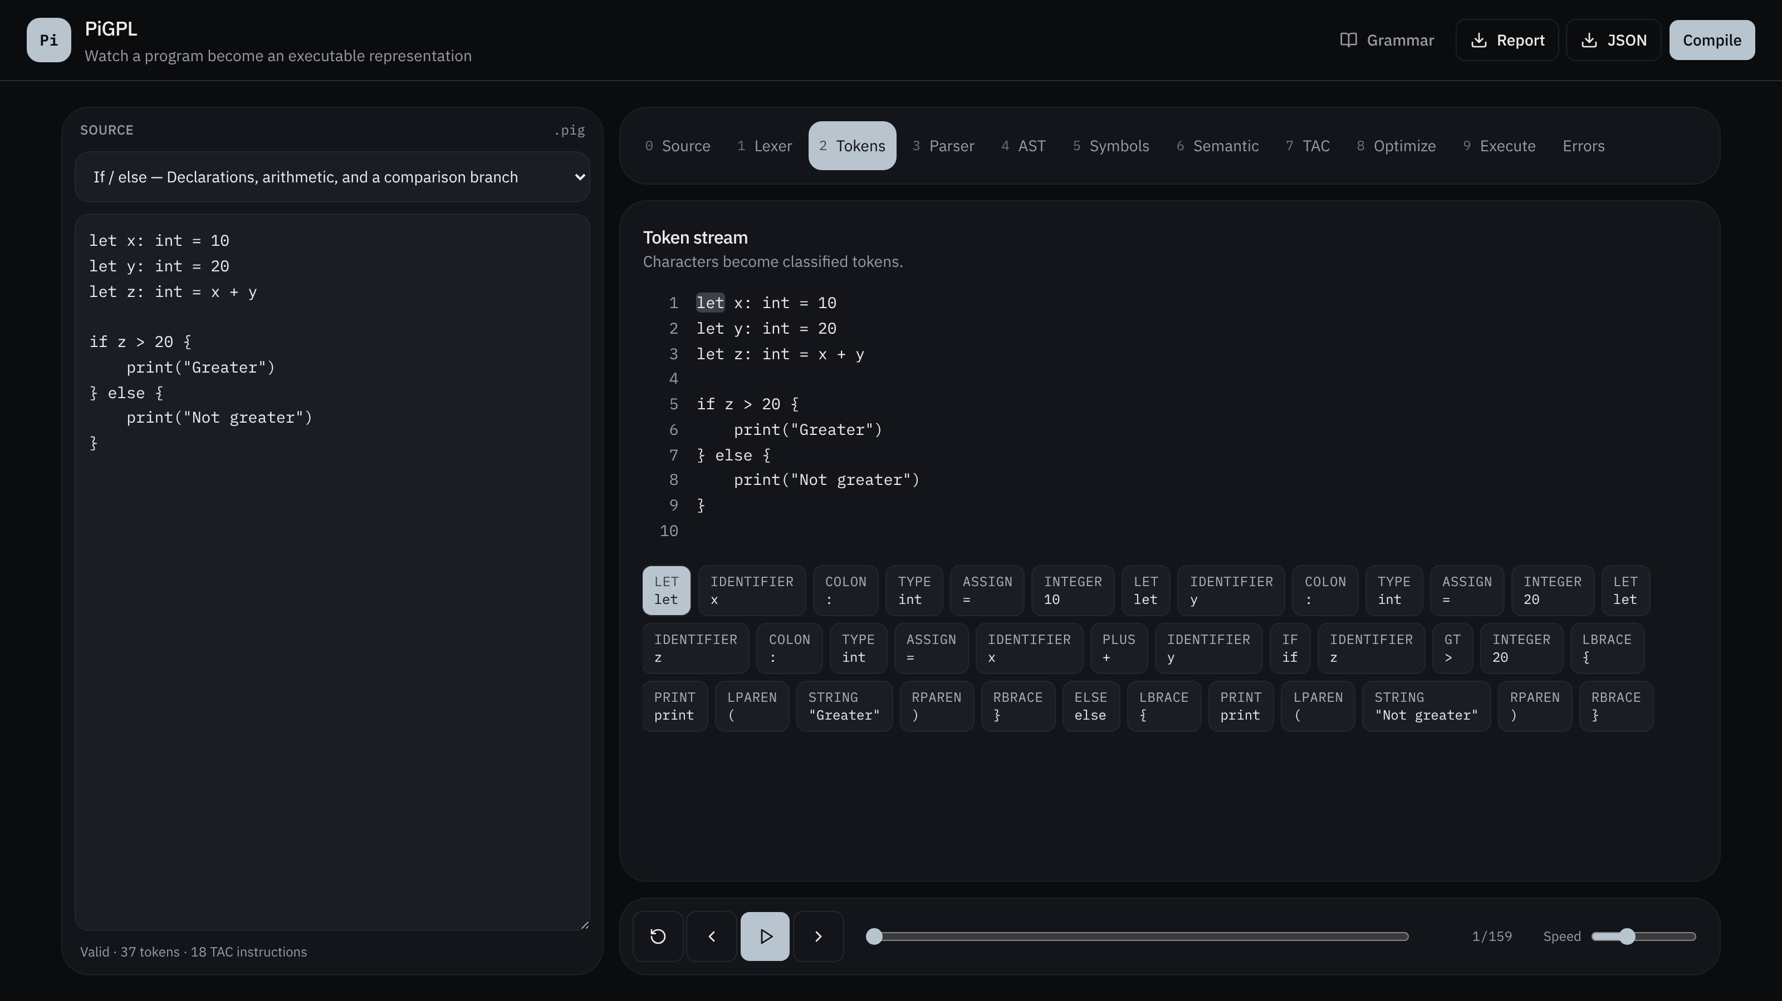
PiGPL
BCSE307L · COMPILER DESIGN
A visual compiler for a Python-inspired language
Source code becomes tokens, a tree, three-address code, optimized code and output — and every step can be replayed.
RATUL PAL (24BAI0353)
RUDRA PRATAP (24BCE0415)
CHRIS K EDISON (24BAI0283)
Notes:
PiGPL stands for Python-inspired General Purpose Language. I built the language and a full compiler for it, plus a web app that shows every phase of the compiler while it works. The screenshot is the real app: the editor on the left, the stage tabs and the token stream on the right, and the replay bar at the bottom.

Slide 2
One program, nine visible phases
THE IDEA
Compiler phases are usually learned on paper. PiGPL compiles a real program, records every small action as an event, and lets you watch, pause and replay each phase.
Source
Lexer
Parser
AST
Symbols
Semantic
TAC
Optimize
Execute
Front end · text → tokens → tree
Middle · names and types
Back end · code → run
Event log
Replay
Export and tests
Every phase writes events — token found, rule reduced, check passed, instruction emitted — each with its source line and column.
Play, step or drag through the events. The 10-line If/else sample produces 159 events, and the stage tabs follow along.
Report (.txt) and JSON downloads of every phase. About 4,200 lines of TypeScript, 13 sample programs, 13 automated tests.
PiGPL · BCSE307L Compiler Design
02 / 07
Notes:
The core design choice: every compiler phase writes to one shared event log. The lexer logs each token, the parser logs each grammar rule it reduces, the semantic phase logs each check, the IR generator logs each instruction. Because every event carries a source location, the app can highlight the exact code that caused it, and the replay bar can move through the whole compilation in order. The pipeline itself is a plain function, compile(source), in pipeline.ts, so the same code runs in the tests and in the browser.

Slide 3
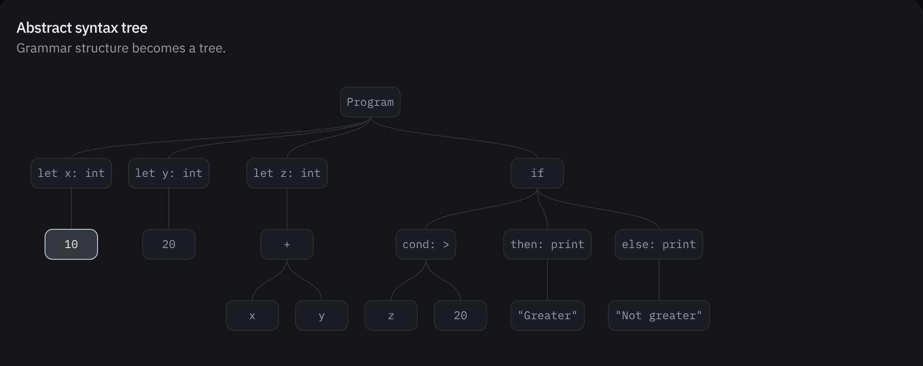
From characters to a tree
FRONT END
or_expr ::= and_expr ("or" and_expr)*
and_expr ::= not_expr ("and" not_expr)*
comparison ::= term (relop term)*
term ::= factor (("+"|"-") factor)*
factor ::= unary (("*"|"/"|"%") unary)*
# (…)* repetition replaces left recursion
Lexer · text to tokens
One pass over the source, character by character, into 42 token types
A bad character becomes an error with line and column; scanning goes on
Parser · tokens to AST
Recursive descent (top-down): one function per grammar rule
Operator precedence comes from how the rules are layered.
PiGPL · BCSE307L Compiler Design
03 / 07
Notes:
Lexer (lexer.ts): a hand-written scanner. It skips spaces and # comments, reads numbers (int or float), strings with escape codes, and identifiers, then checks a keyword table. Two-character operators are checked before one-character ones, which is the longest-match rule from lexical analysis. Errors do not stop the scan. Parser (parser.ts): recursive descent, as in top-down parsing. Each grammar level calls the next tighter level, so * binds tighter than + without any precedence table. The grammar uses repetition instead of left recursion, which a top-down parser cannot handle. Most decisions need one token of lookahead; a statement that starts with a name needs two, to tell x = ..., x[...] = ... and f(...) apart. Panic-mode recovery skips tokens until a statement-start token, so one mistake does not hide the rest of the errors. The AST picture is the real output for the If/else sample.

Slide 4
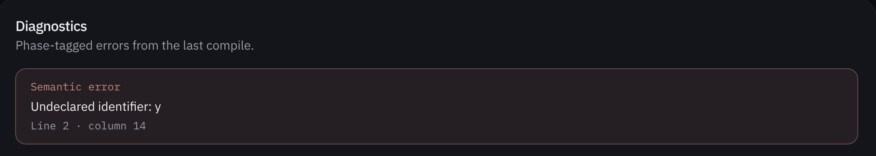
Names, scopes and types
MIDDLE
Symbol table · Functions and For-range samples
Checks before any code runs
Name | Type | Scope | Kind
add | fn(int,int)->int | global | fn
a | int | fn:add | param
b | int | fn:add | param
s | int | global | var
i | int | for:i:10 | loop
Every name is declared before use
No second let for a name in one scope
Types agree: int and float mix, "a" + 1 does not
if and while conditions are bool
Calls match parameter count and types
return matches the function's type
One failed check blocks execution.
PiGPL · BCSE307L Compiler Design
04 / 07
Notes:
The symbol table (symbol-table.ts) keeps every declared name with its type, scope and kind. Scopes are a stack: global, then fn:add inside a function, then for:i:10 inside a loop (the number is the loop's position, so two loops never clash). The semantic pass (semantic.ts) walks the AST, fills the table and records each check as passed or failed, so the Semantic tab shows a green tick or red cross per check. Every failed check is also a phase-tagged error with line and column, like the undeclared y shown here. If any semantic error exists, the Execute stage does not run.

Slide 5
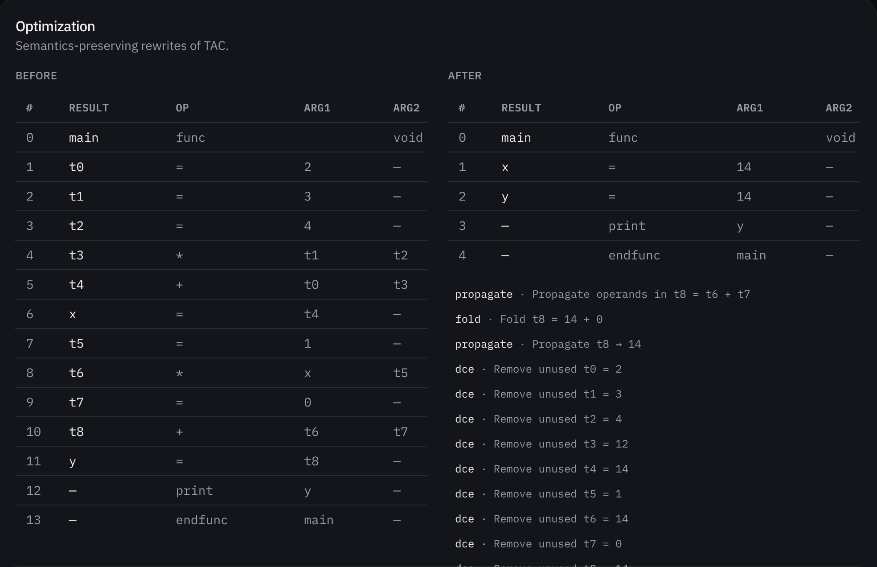
Three-address code, then optimization
BACK END
The AST is flattened into quadruples (result, op, arg1, arg2). if, while and for become labels, ifFalse and goto.
Pass | What it does | Example
fold | Do constant math now | 3 * 4 → 12
propagate | Use a known value | t3 → 12
algebraic | Drop useless math | x * 1 → x
dce | Delete unused temps | t0 = 2 → ∅
PiGPL · BCSE307L Compiler Design
05 / 07
Notes:
IR generation (ir.ts) walks the AST and emits quadruples. Every literal and every sub-expression gets a temporary t0, t1 and so on. Control flow is lowered with labels: an if becomes ifFalse cond goto L1, then-block, goto L0, L1: else-block, L0:. A for over a number becomes a counter loop; a for over a list or string uses an index and len. Functions become func ... endfunc blocks with param and call. The optimizer (optimizer.ts) does local, peephole-style passes: constant folding, constant propagation, algebraic simplification (x+0, x*1, x*0, x/1) and dead-code elimination of unused temporaries. It runs again until a round makes no change, with a limit of 6 rounds. The screenshot is the Constant-fold sample: let x = 2 + 3 * 4 and let y = x * 1 + 0 go from 14 instructions to 5, and x and y both become 14.

Slide 6
Measured on the 10 valid sample programs
RESULTS
−20%
−64%
13/13
120
TAC instructions after optimization, 166 → 133 in total
On the Constant-fold sample, 14 → 5 instructions
Automated pipeline tests pass, lexer to execute
fact(5), computed by real recursive calls
Execute stage
Error reporting
A TAC interpreter with one stack frame per call (locals and return address). An 8,000-step limit stops endless loops.
Every error is tagged Lexical, Syntax, Semantic or Runtime, with line and column. All 3 error samples are caught at the right phase.
PiGPL · BCSE307L Compiler Design
06 / 07
Notes:
These numbers come from running compile() on every sample program in the project. The 10 valid samples have 166 TAC instructions before optimization and 133 after, about 20 percent fewer. The gain depends on how much constant math a program has: the Constant-fold sample drops 64 percent, while Lists and Functions do not change, because their values are only known at run time. All 13 tests in pipeline.test.ts pass (node --test). The recursive factorial sample prints 120, which shows that param, call and return work with a real call stack. The three error samples are each caught by the expected phase: the @ character by the lexer, the missing expression by the parser, and the undeclared name by the semantic checks.

Slide 7
TAKEAWAY
PiGPL turns the textbook compiler pipeline into something you can run, watch and test, one phase at a time.
PiGPL · BCSE307L Compiler Design
07 / 07
Notes:
I list the limits openly because they show where the design stops. Functions get their own frame, so an assignment to a global inside a function is lost. Division always gives a decimal. Divide by zero and an out-of-range index return 0 instead of a runtime error. The optimizer works inside one basic block and only rewrites assignments and arithmetic, so a constant is not pushed into a print, return or param operand. The next steps follow the course order: first make the run-time behaviour strict, then build a control-flow graph to allow global optimizations, and last, generate real target code with register allocation. Thank you; I can show a live demo of any sample program.

